Slide 1
CAPSTONE PROJECT SECURE DATA HIDING IN IMAGE USING
STEGANOGRAPHY
Presented By: Hrithik Shinde Student Name : Hrithik Shinde
College Name & Department : Nanasaheb Mahadik College of Enginerring, Computer Science and Enginering

Slide 2
OUTLINE
Problem Statement
Technology used
Wow factor
End users
Result
Conclusion
Git-hub Link
Future scope

Slide 3
PROBLEM STATEMENT
Sensitive information needs secure transmission without attracting attention.
Encryption can raise suspicion, making it a target for attacks.
There is a need for a method that:
Hides data without altering the image noticeably
Ensures security and confidentiality
Maintains data integrity even if the image is modified

Slide 4
TECHNOLOGY USED
▪ | 1. Programming Languages
• | Python – The main language for writing the steganography program.
▪ | 2. Steganography Techniques (How we hide the data!)
• | Least Significant Bit (LSB) Steganography – Hides data in the tiniest details of an image so that no one notices.
• | Discrete Cosine Transform (DCT) Steganography – Hides data inside compressed image formats like JPEG.
• | Discrete Wavelet Transform (DWT) Steganography – More advanced, hiding data in different layers of an image.
▪ | 3. Extra Security with Encryption (For making the hidden data even safer!)
• | AES (Advanced Encryption Standard) – Scrambles the secret data before hiding it.
• | RSA (Rivest-Shamir-Adleman) – Uses a public-private key system for even stronger protection.
▪ | 4. Tools & Libraries (The building blocks for coding!)
• | OpenCV2 – Helps with image processing and manipulation.
• | Pillow (PIL) – Another great library for working with images in Python.
• | NumPy – Speeds up calculations and handles pixel data efficiently.
▪ | 5. Checking Our Work: Image Quality Metrics
• | PSNR (Peak Signal-to-Noise Ratio) – Helps ensure the image still looks normal after hiding data.
• | MSE (Mean Squared Error) – Measures how much the image has changed.

Slide 5
WOW FACTORS
1. A Killer Design
Go for a dark cyber theme with neon or glowing text to give that hacker-tech feel.
Use minimal text and powerful visuals (nobody likes reading a wall of text!).
Add subtle animations to keep it smooth and professional.
2. Show, Don’t Just Tell!
Use a before-and-after image to show how an image looks the same even after hiding data inside it.
Add a GIF or short video of steganography in action—hiding and extracting a message.
If possible, do a quick live demo—hide a message in an image and reveal it!
Make It Interactive
Add a QR code that links to a secret message hidden inside an image—let your audience scan and see for themselves!
Show two images side by side and ask, "Can you guess which one has hidden data?"—then reveal the answer!
Fun & Easy-to-Understand Analogies
Explain steganography like a spy mission—messages hidden in plain sight!
Mention real-life examples, like how spies and hackers use steganography to send hidden messages.
Compare it to a magic trick—the audience sees an ordinary image, but there’s a secret inside.
Display an image and say: “There’s a hidden message in this picture. Can you find it?”
Security Test Challenge
Display an image and say: “There’s a hidden message in this picture. Can you find it?”
Let them try to guess before you reveal the hidden message!
Future of Steganography
Talk about how AI-powered steganography is the next big thing!
Mention how this tech is used in cybersecurity, forensics, and even protecting whistleblowers.
End with a Mystery
Show an image and say, “There’s a hidden message in this. Want to find out?”
Give them a tool or a hint—leave them curious and amazed!

Slide 6
END USERS
Cybersecurity Experts – Hide sensitive data without raising suspicion.
Government & Intelligence Agencies – Secure military and confidential communication.
Journalists & Whistleblowers – Share secret information safely.
Law Enforcement & Forensics – Track criminals who use hidden messages.
Content Creators – Protect images, videos, and music with hidden watermarks.
Businesses – Secure company data and prevent corporate spying.
Everyday Users – Send private messages secretly.

Slide 7
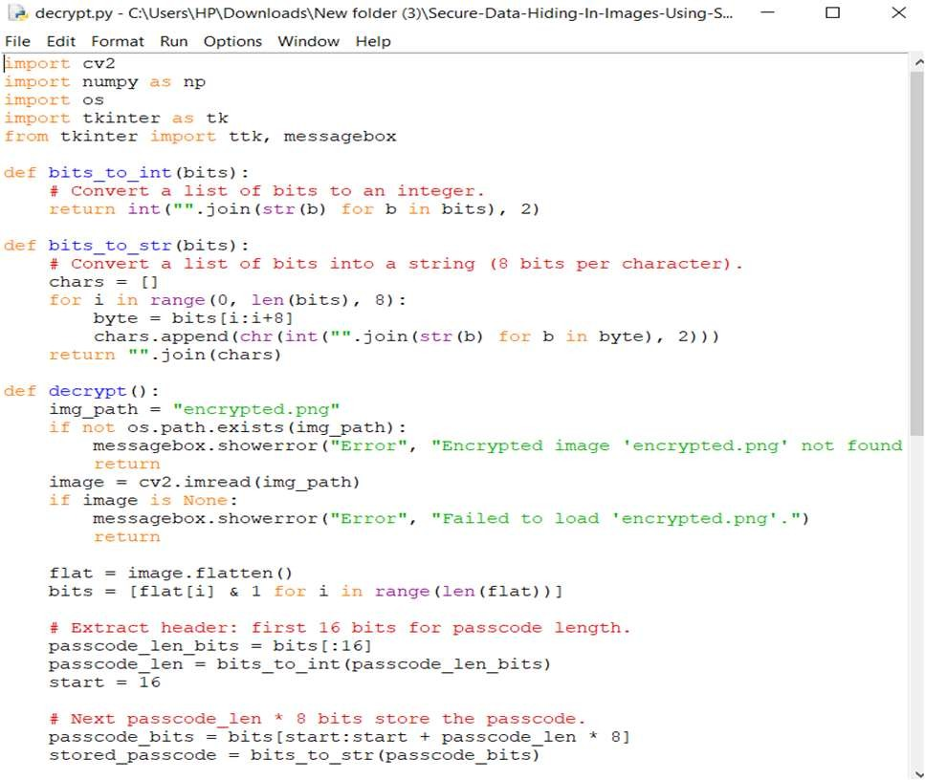
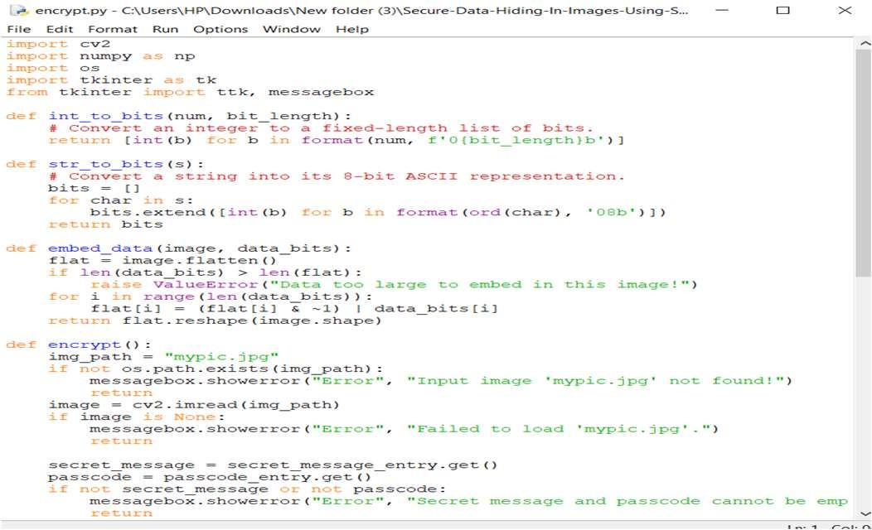
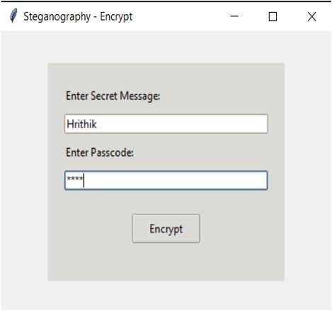
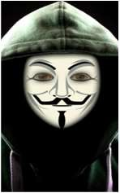
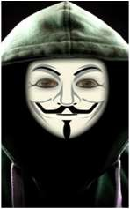
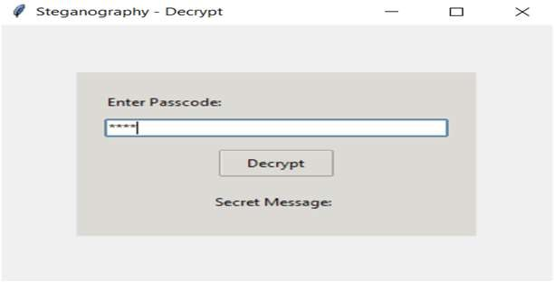
RESULTS

Slide 8
CONCLUSION
Steganography is a powerful technique for hiding sensitive information inside images.
Unlike encryption, it keeps data invisible, reducing the risk of detection.
It has applications in cybersecurity, forensics, secure communication, and copyright protection.
With advancements in AI and cryptography, steganography will continue to evolve for even stronger security.
This project demonstrates how hidden data can be securely embedded and retrieved while maintaining image

Slide 9
GITHUB LINK
https://github.com/Hrithik9767/secure-data-hiding-in-image-using-steganography.git

Slide 10
FUTURE SCOPE(OPTIONAL)
AI-Powered Steganography – Using machine learning to create even more secure and undetectable hidden messages.
Quantum Steganography – Future quantum computing could enhance data hiding techniques for ultra-secure communication.
Enhanced Security with Blockchain – Combining steganography with blockchain for secure,
tamper-proof data storage.
Steganography in Video & Audio – Expanding beyond images to hide data in videos, audio, and even live streams.
Improved Detection Resistance – Developing advanced algorithms to make steganography
more resistant to detection and attacks.
Applications in IoT & Cloud Security – Protecting sensitive IoT data and ensuring secure cloud communications.

Slide 11
THANK YOU

